Slide 1
Secure Data hiding in images using steganography
CAPSTONE PROJECT
Presented By: Abhyuday Jain
Student Name : Abhyuday Jain
College Name & Department : University Department Rajasthan Technical University & IT(Information Technology) department

Slide 2
OUTLINE
Problem Statement
Technology used
Wow factor
End users
Result
Conclusion
Git-hub Link
Future scope

Slide 3
Problem Statement
In today's digital age, secure communication is essential. This project addresses the challenge of encrypting and decrypting secret messages within images to ensure confidentiality and data protection.

Slide 4
Technology used
Python
OpenCV Library
Git and GitHub
Visual Studio Code

Slide 5
Wow factors
Unique Message Concealment: Embedding messages within images provides an extra layer of security.
User-friendly Interface: Simple prompts for entering the secret message and passcode.
Secure Decryption: Passcode verification ensures only authorized access.
Visual Encryption: Unlike traditional text-based encryption, this method uses images which adds a unique visual element.

Slide 6
End users
Individuals: For personal secure communication.
Organizations: To protect sensitive information.
Cybersecurity Enthusiasts: For learning and experimentation with encryption techniques.
Students and Educators: In computer science and cybersecurity courses.

Slide 7
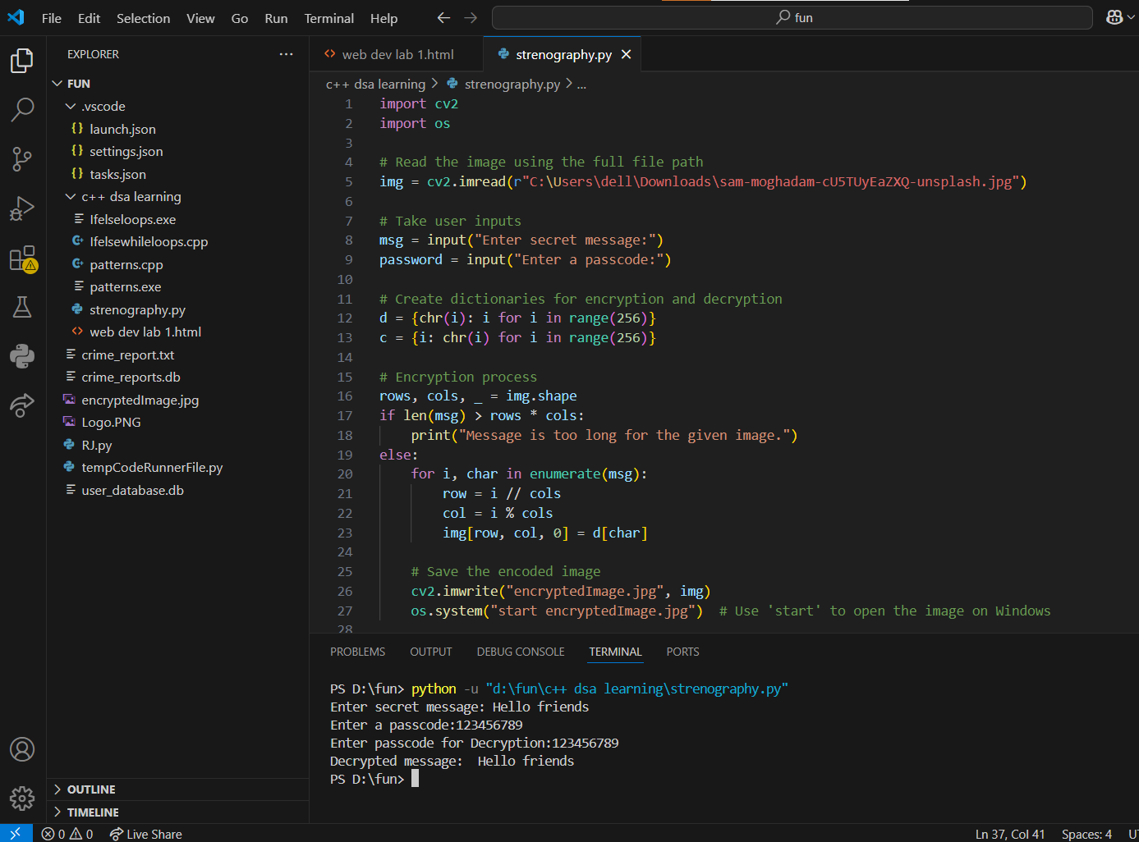


Results
Original image
Encrypted image

Slide 8
Conclusion
Our project successfully demonstrates the process of encrypting and decrypting secret messages within images. By utilizing Python and OpenCV, we offer a secure and efficient solution for confidential communication.

Slide 9
GitHub Link
https://github.com/abhyudayjj/steganography-project

Slide 10
Future scope(optional)
Enhancement of the encryption algorithm for higher security.
Integration with mobile applications for wider accessibility.
Addition of more advanced features like image watermarking.

Slide 11
THANK YOU

